Slide 1
SuperStore Sales Performance
Annual Sales Dashboard

Slide 2

Executive Summary: Key Performance Indicators
Total Sales: $2,000,000
Total Profit: $175,000
Total Orders: 22,000
Regional Markets: Actively selling across 4 key regions.
Key Takeaway: A strong year with significant sales and profit, demonstrating robust market presence.

Slide 3
Monthly Performance: Sales & Profit Trends
Sales Trend: Sales show a consistent upward trend throughout the year, with a significant peak in the final quarter (October-December).
Profit Trend: Profitability mirrors the sales trend, with notable growth in the later months.
Insight: The end-of-year period is critical for both revenue and profit generation, likely driven by holiday sales or year-end business purchasing.

Slide 4
Customer & Regional Analysis
Sales by Customer Segment:
Consumer: 48% (Largest segment)
Corporate: 33%
Home Office: 19%
Sales by Region:
West: 33% (Top-performing region)
East: 29%
Central: 22%
South: 16%
Insight: The Consumer segment in the West region represents our most significant market concentration.

Slide 5
Product Insights: Top Categories & Sub-Categories
Top Categories by Sales:
Office Supplies: $640,000
Technology: $470,000
Furniture: $450,000
Top 5 Sub-Categories by Sales:
Phones: $200,000
Storage: $150,000
Tables: $120,000
Paper: $100,000
Supplies: $40,000
Insight: While Office Supplies is the top category overall, high-value Technology items like Phones are major revenue drivers.

Slide 6
Operational Insights: Shipping & Payment
Preferred Shipping Mode:
Standard: 910K (Overwhelmingly the most used)
Second Class: 310K
First Class: 240K
Same Day: 100K
Popular Payment Methods:
COD (Cash on Delivery): 43%
Online: 35%
Cards: 22%
Insight: The majority of our customers prefer standard shipping and flexible payment options like COD.

Slide 7
Geographical Sales Distribution
Overview: The map indicates a strong sales presence across the United States.
Key Concentrations: Major sales hubs are concentrated on the East and West coasts, particularly in states like California, New York, and Texas, as indicated by the larger circles.
Opportunity: There appears to be room for growth in the central and southeastern states.

Slide 8
Summary & Key Takeaways
Strong Finish: The business shows powerful year-end performance, which should be a focus for future marketing and inventory efforts.
Core Market: Our primary customer is in the Consumer segment, located in the West region, and prefers Standard Shipping.
Top Products: Office Supplies lead in overall category sales, but Phones are the single most profitable sub-category.
Growth Areas: Opportunities exist to expand our footprint in the South and Central regions and to promote faster shipping options.

Slide 9
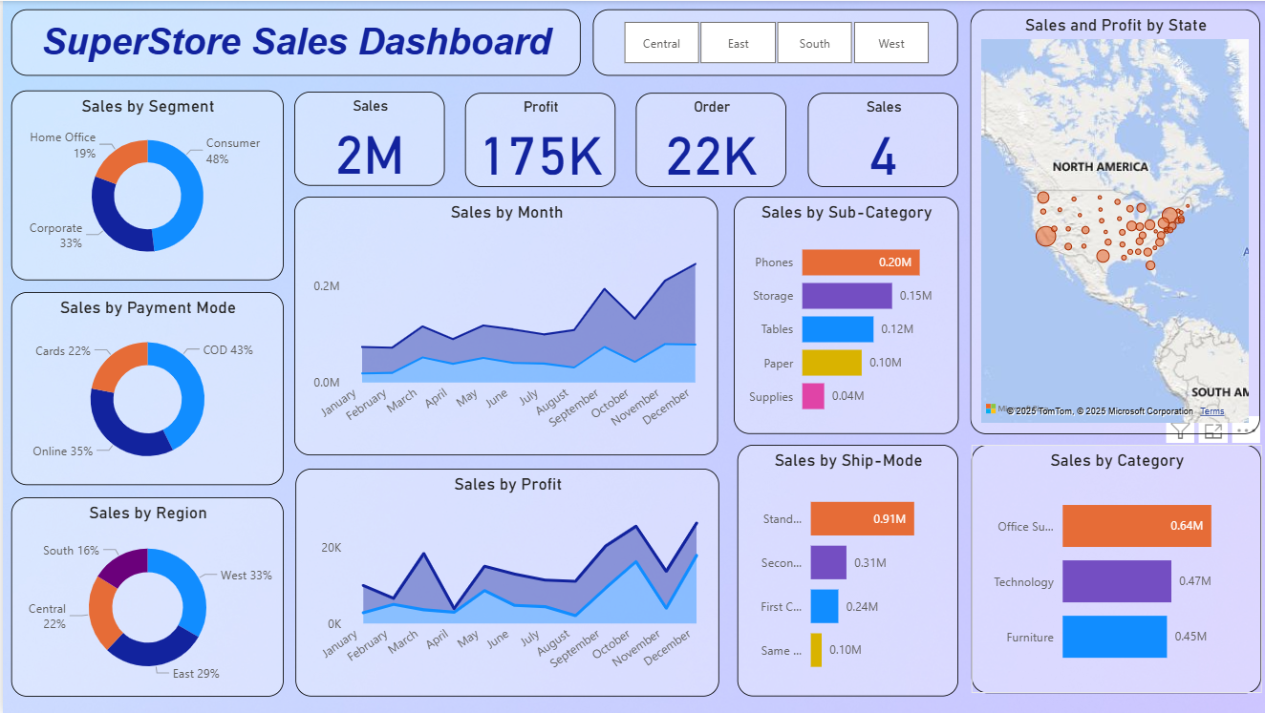

Slide 10


